Slide 1

SimplyShop
Transforming Retail with Data-Driven Automation
Notes:
In the world of retail, data is the key to unlocking better customer experiences and smarter business decisions. Yet, for many offline stores, the ability to collect meaningful data is severely limited. Traditionally, the only data captured comes from the point of sale (POS), where transactions are recorded in a digital format. But this barely scratches the surface of a customer’s shopping journey. What about the products they considered but didn’t buy? What caught their eye? What made it to the fitting room but didn’t leave with them? These critical insights are often lost, leaving store owners with a blind spot in understanding their customers' behaviors and preferences.

Slide 2

Current Retail Challenges
Limited data collection in physical stores.
Only digital data typically captured is at the point of sale.
Store owners lack insights into what products customers consider but don’t buy.
Result: Blind spots in understanding customer behavior and preferences.
Notes:
In the world of retail, data is the key to unlocking better customer experiences and smarter business decisions. Yet, for many offline stores, the ability to collect meaningful data is severely limited. Traditionally, the only data captured comes from the point of sale (POS), where transactions are recorded in a digital format. But this barely scratches the surface of a customer’s shopping journey. What about the products they considered but didn’t buy? What caught their eye? What made it to the fitting room but didn’t leave with them? These critical insights are often lost, leaving store owners with a blind spot in understanding their customers' behaviors and preferences.

Slide 3
SimplyShop
SimplyShop captures every step of the customer shopping journey—from browsing to purchase—providing store owners with comprehensive data and insights.
Features:
In-store digital kiosks
Fitting room scanners
POS Integration
Notes:
SimplyShop solves these challenges by capturing every step of the customer shopping journey-from browsing the items to purchasing-providing store owners with comprehensive data insights.

Slide 4
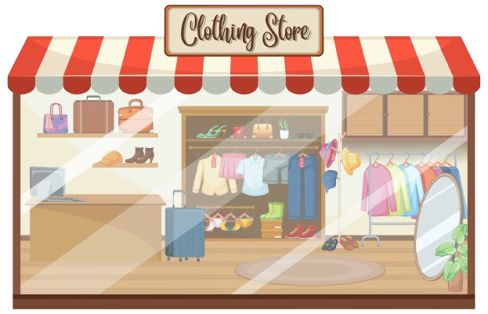

Notes:
Imagine Sarah walks into a clothing store. The store is equipped with SimplyShop, a revolutionary system designed to capture every step of her shopping journey.

Slide 5

Notes:
As Sarah enters, she notices a sleek digital kiosk where she can browse the latest collections, search for specific items, and receive personalized recommendations. Intrigued, she adds a few pieces to her digital cart—items that caught her interest. This is our first touchpoint: we’ve captured data on what initially draws Sarah in.

Slide 6

Notes:
She then decides to try on some of these clothes, picks them from the store, and heads to the fitting room.

Slide 7

Notes:
As she was going to the fitting room, she spots a dress that catches her eye. Even though she had not added this dress to her digital cart, she picks it up as well and heads to the fitting room. Here’s where SimplyShop steps in again. Before entering the fitting room, Sarah is prompted to scan all the items she’s trying on. This allows us to record data on the items that make it to the ‘trial’ stage. If Sarah decides not to buy the dress after trying it on, we capture that data too, revealing insights into why certain products don’t make the cut.

Slide 8


Notes:
In another scenario, Sarah picks up a purse directly from the shelf, bypassing both the kiosk and the fitting room, and heads straight to checkout. At the POS, her purchase is recorded as she completes her transaction.
By tracking these multiple touchpoints—browsing, trying on, and purchasing—SimplyShop provides store owners with a complete picture of customer behavior within the store. This data is more than just numbers; it’s a roadmap to understanding what drives sales and what doesn’t. With this information, store owners can optimize product placements, tailor marketing campaigns, and fine-tune their inventory—all based on real customer interactions.

Slide 9
Enhancing customer shopping experience
Real-Time Inventory Checks: The system knows exactly what sizes and items are available in the store.
Customer Requests: Easily request out-of-stock sizes or items.
Automated Notifications: Receive email alerts when requested items are back in stock.
Notes:
But SimplyShop goes beyond data collection. It enhances the shopping experience and saves customers time. The system knows exactly what sizes are available in the store, and if a size isn’t in stock, customers can request it. When that size becomes available, the system automatically sends them an email notification.

